Slide 1
Module information
Lecturer information:
Class Teacher: Eng. Janvier NIYITEGEKA
Email: jniyitegeka@iprctumba.rp.ac.rw
TEL: +250788973044
Linkedin: https://www.linkedin.com/in/eng-janvier-niyitegeka-3125a0166/
Office Hours :
Monday: 2:00pm-5:00pm
Wednesday: 8:00-9:50AM
Thursday: 8:00-9:50AM
Extra hours by appointment
Class Location:
M.Hall, IT.Lab3
Course Evaluation:
In Class QUIZES and Assignments: 35Marks/ Practice: 25marks
End of semester Exam: 40Marks/ Provisional date: 03/09/2021(Theory)

Slide 2
REN302: AUTOMATION CONTROL SYSTEM
Lecture 2
INDUSTRIAL SENSORS MEASUREMENTS
Eng. NIYITEGEKA Janvier
RP/IPRC TUMBA/ RE DEPARTMENT

Slide 3

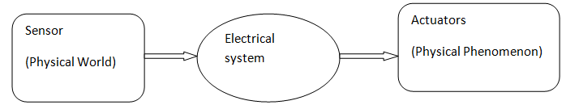
Sensor Measurement

Slide 4

What is Sensor?
Definition: A sensor is a device that converts a physical phenomenon into an electrical signal.
The other part of this interface is represented by actuators, which convert electrical signals into physical phenomena.
TRANSDUCERS Convert One Type of Energy into Another .

Slide 5
Sensor Systems:
Based on their need for power supply. The sensors are of two types :
Active Sensors which require an external Source of excitation such as RTDs.
Passive (Self-Generating) Sensors that do not need an external power source: Thermocouples, Photodiodes, Piezoelectric.

Slide 6
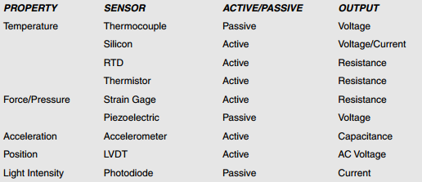

Slide 7
1) Temperature Measurement
Temperature is defined as a specific degree of hotness or coldness.
It can also be defined as the amount of heat energy in an object or system.
Temperature sensors detect a change in a physical parameter such as resistance or output voltage that corresponds to a temperature change.

Slide 8
Basic types of temperature sensing:
Contact: temperature sensing requires the sensor to be in direct physical contact with the media or object being sensed.
b) Non-contact : measurement interprets the radiant energy of a heat source in the form of energy emitted in the infrared portion of the electromagnetic spectrum.

Slide 9
Temperature Sensor Types and Technologies
Temperature sensors are classified into three families: electro-mechanical, electronic, and resistive.
a) Electro-mechanical
The bi-metallic switch is a discrete (on-off) sensor that takes advantage of the fact that as materials are heated they expand, and that for the same change in temperature, different types of material expand differently.

Slide 10
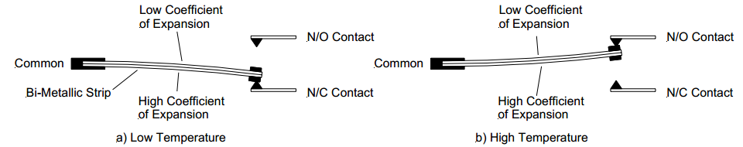
Bi-metallic Temperature Switch

Slide 11
Cont’d
The bi-metallic strip consists of two different metals that are bonded together.
The metals are chosen so that their coefficient of temperature expansion is radically different.
Since the two metals in the strip will be at the same temperature, as the temperature increases, the metal with the larger of the two coefficients of expansion will expand more and cause the strip to warp.

Slide 12
b) Electronic
Infrared (IR) pyrometry. All objects emit infrared energy provided their temperature is above absolute zero (0 Kelvin).
IR sensors measure the infrared energy emitted from an object in the 4–20 micron wavelength and convert the reading to a voltage.

Slide 13
c) Resistance Thermometers
It is well known that resistance of metallic conductors increases with temperature, while that of semiconductors generally decreases with temperature.
Resistance thermometers employing metallic conductors for temperature measurement are called Resistance Temperature Detector (RTD), and those employing semiconductors are termed as Thermistors.
RTDs have more or less linear characteristics over a wide temperature range. On the other hand Thermistors have high temperature sensitivity, but nonlinear characteristics.

Slide 14
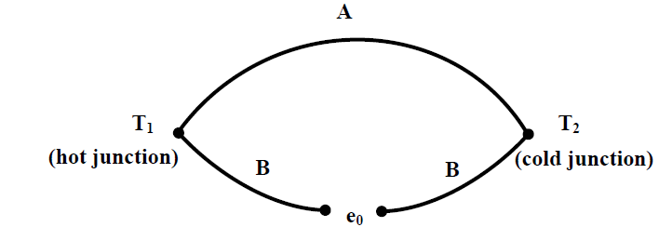
d) Thermocouple

Slide 15
Thermocouple cont’d
Thermocouple is a transducer consisting of two different metals welded together at each end;
a voltage is produced that is proportional to the difference between in temperature between two junctions where one is maintained at known temperature.

Slide 16
Cont’d
Thermocouples are extensively used for measurement of temperature in industrial situations.
The major reasons behind their popularity are:
(i) their readings are consistent,
(ii) they can measure over a wide range of temperature, and
(iii) their characteristics are almost linear with an accuracy of about 0.05%.

Slide 17
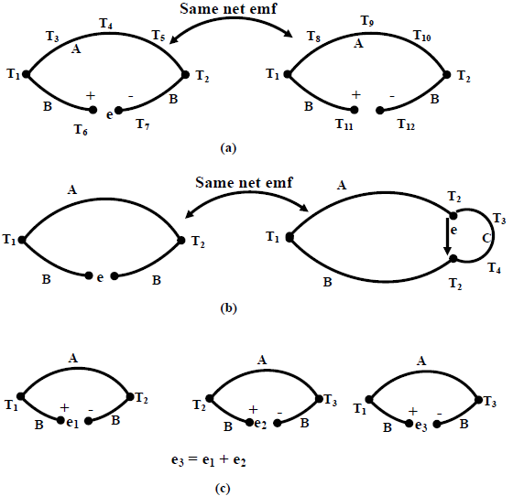
Laws of Thermocouple

Slide 18
The first law can be explained using Fig.(a). It says that the net thermo-emf generated is dependent on the materials and the temperatures of two junctions only, not on any intermediate temperature.
According to the second law, if a third material is introduced at any point (thus forming two additional junctions) it will not have any effect, if these two additional junctions remain at the same temperatures (Fig.(b)).
This law makes it possible to insert a measuring device without altering the thermo-emf.

Slide 19
The third law is related to the calibration of the thermocouple.
It says, if a thermocouple produces emf e₁, when its junctions are at T₁ and T₂, and e₂ when its junctions are at T₂ and T₃;
then it will generate emf e₁+e₂ when the junction temperatures are at T₁ and T₃ (Fig.(c)).

Slide 20
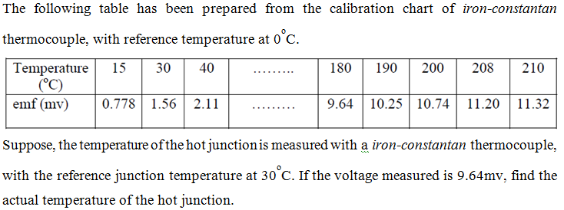
Exercise

Slide 21
2) Displacement Measurement
Besides the measurement principles can be classified into two categories: electrical sensing and optical sensing.
In electrical sensing, passive electrical sensors are used variation of either inductance or capacitance with displacement is measured.
On the other hand the optical method mainly works on the principle of intensity variation of light with distance.

Slide 22
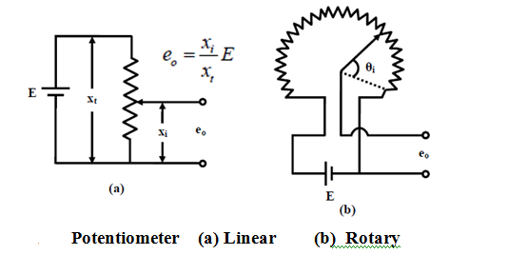
a) Potentiometer

Slide 23
Potentiometer cont’d
A potentiometer is a three terminal resistor with a sliding or rotating contact that forms an adjustable voltage divider. If only two terminals are used, one end and the wiper, it acts as a variable resistor or rheostat.
The measuring instrument called a potentiometer is essentially a voltage divider used for measuring electric potential (voltage).
Potentiometers are commonly used to control electrical devices such as volume controls on audio equipment.

Slide 24
Potentiometer as sensor
The potentiometer is also one of the most commonly used device for measuring the displacement of the body.
The potentiometer is the electrical type of transducer or sensor and it is of resistive type because it works on the principle of change of resistance of the wire with its length.
The resistance of the wire is directly proportional to the length of the wire, thus as the length of the wire changes the resistance of the wire also changes.
The potentiometer is an electric circuit in which the resistance can be changed manually by the sliding contacts.
They are the resistive type of transducers and the output voltage is proportional to the displacement

Slide 25
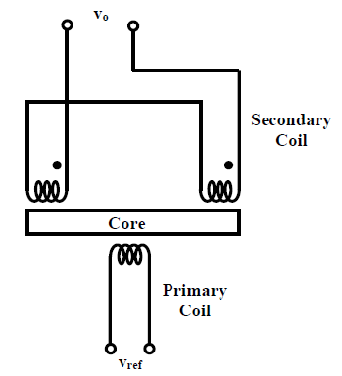
b) Linear Variable Differential transformer (LVDT)

Slide 26
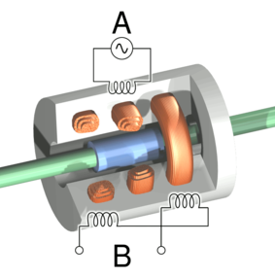

Slide 27
Cont’d
LVDT works on the principle of variation of mutual inductance. It is one of the most popular types of displacement sensor.
An LVDT (linear variable differential transformer is an electromechanical sensor used to convert mechanical motion or vibrations, into a variable electrical current, voltage or electric signals.
The two secondary windings are connected in series opposition, so that the net output voltage is the difference between the two.
The output voltage is zero when the core is at central position (voltage induced in both the secondary windings are same, so the difference is zero) but increasing as the core moves away from the central position, in either direction.

Slide 28
Cont’d
Physically, the LVDT construction is a hollow metallic cylinder in which a shaft of smaller diameter moves freely back and forth along the cylinder’s long axis.
A linear displacement transducer is an electrical transducer used in measuring linear position.
Linear displacement is the movement of an object in one direction along a single axis.
Measuring displacement indicates the direction of motion.
The output signal of the linear displacement sensor is the measurement of the distance an object has traveled in units of millimeters (mm), or inches (in.), and can have a negative or positive value

Slide 29
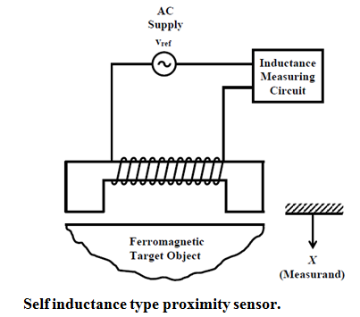
c) Inductive type Sensors

Slide 30
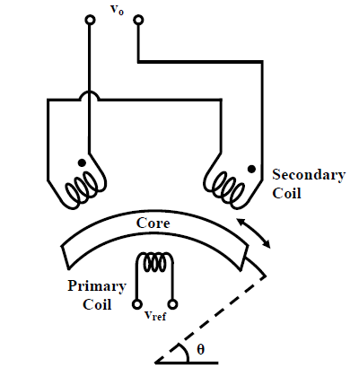
d)Rotary Variable Differential Transformer (RVDT)

Slide 31
Cont’d
LVDT works on the principle of variation of mutual inductance.
There are inductive sensors for measurement of displacement those are based on the principle of variation of self inductance. These sensors can be used for proximity detection.
In this case the inductance of a coil changes as a ferromagnetic object moves close to the magnetic former, thus change the reluctance of the magnetic path. The measuring circuit is usually an a.c. bridge

Slide 32
Cont’d
Its construction is similar to that of LVDT, except the core is designed in such a way that when it rotates the mutual inductance between the primary and each of the secondary coils changes linearly with the angular displacement

Slide 33
e) Capacitance Sensors
A capacitance sensor can be formed by either varying (i) the separation (d), or, (ii) the area (A), or (iii) the permittivity (ε_{r}).
A displacement type sensor is normally based on the first two (variable distance and variable area) principles, while the variable permittivity principle is used for measurement of humidity, level, etc.

Slide 34
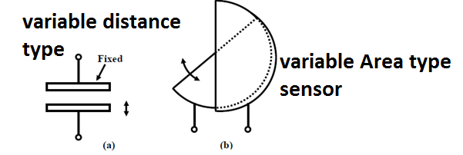
Cont’d

Slide 35
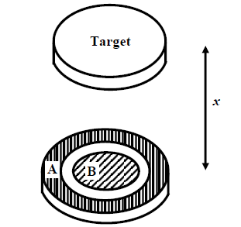
Capacitive proximity type sensor
Its measuring head consists of two electrodes, one circular (B) and the other an annular shaped one (A); separated by a small dielectrical spacing.
When the target comes in the closed of the sensor head, the capacitance between the plates A and B would change, which can be measured by comparing with a fixed reference capacitor.

Slide 36
f) Optical Sensors
Optical displacement sensors work on the basic principle that the intensity of light decreases with distance.
So if the source and detector are fixed, the amount of light reflected from a moving surface will depend on the distance of the moving surface from the fixed ones.
Measurement using this principle requires proper calibration since the amount of light received depends upon the reflectivity of the surface, intensity of the source etc.

Slide 37
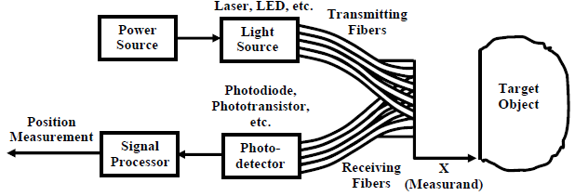
Fiber optic position sensor

Slide 38
3) Speed Measurement
The simplest way for speed measurement of a rotating body is to mount a tachogenerator on the shaft .
The most popular type of speed sensor is the tachogenerator.
The tachogenerator is mounted on the shaft and the voltage induced that is proportional to the speed is measured.

Slide 39
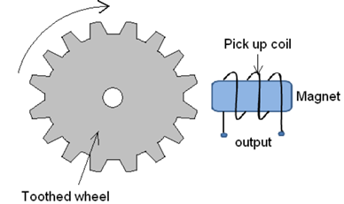
Tachogenerator Sensor
Tachogenerator consists of an assembly of a toothed wheel and a magnetic
Toothed wheel is mounted on the shaft or the element of which angular motion is to be measured.
Magnetic circuit comprising of a coil wound on a ferromagnetic material core.
As the wheel rotates, the air gap between wheel tooth and magnetic core changes which results in cyclic change in flux linked with the coil.
The alternating emf generated is the measure of angular motion.

Slide 40
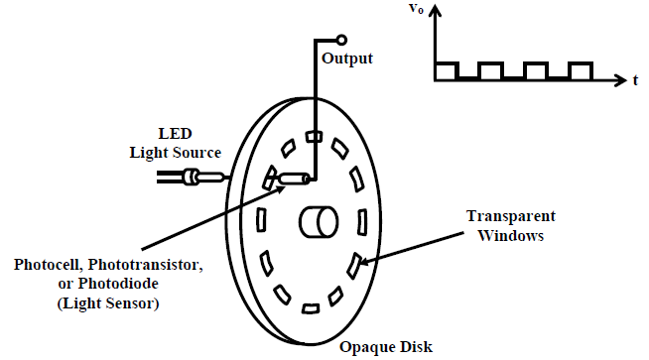
Noncontact type measurements
An opaque disc with perforations or transparent windows at regular interval is mounted on the shaft whose speed is to be measured.
A LED source is aligned on one side of the disc in such a way that its light can pass through the transparent windows of the disc.

Slide 41
Cont’d
As the disc rotates the light will alternately pass through the transparent windows and blocked by the opaque sections.
A photo detector fixed on the other side of the disc detects the variation of light.
The output of the detector after signal conditioning would be a square wave (as shown) whose frequency is decided by the speed and the number of holes (transparent windows) on the disc.

Slide 42
4)Level Measurement
There are different methods for measuring the liquid level:
Hydrostatic differential pressure gage type
Capacitance type
Ultrasonic type
Radiation technique.

Slide 43
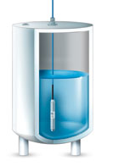
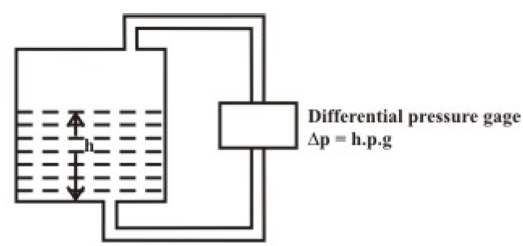
Hydrostatic differential pressure gage type

Slide 44
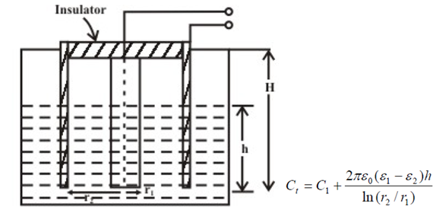
Capacitance type

Slide 45
Cont’d
This type of sensors are widely used for chemical and petrochemical industries.
It can be used for a wide range of temperature (-40 to 200 ºC) and pressure variation (25 to 60 kg/cm²).
It uses a coaxial type cylinder, and the capacitance is measured between the inner rod and the outer cylinder.

Slide 46
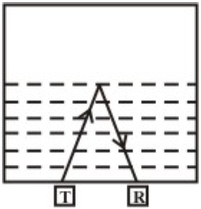
Ultrasonic type
Ultrasonic method can be effectively used for measurement of liquid level in a sealed tank.
An ultrasonic transmitter/receiver pair is mounted at the bottom of the tank. Ultrasonic wave can pass through the liquid, but gets reflected at the liquid-air interface.
The time taken to receive the pulse is measured, that can be related with the liquid level.

Slide 47
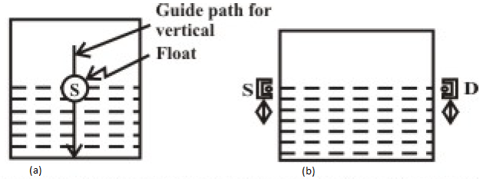
Radiation technique

Slide 48
Cont’d
Radioactive ray gets attenuated as it passes through a medium.
The method used in a batch filling process of bottles, uses a source-detector assembly that can slide along the two sides of the bottle.
As soon as the source-detector assembly passes through the liquid-air interface, there would be a large change in the signal received by the detector.

Slide 49
5) Humidity Measurement
Moisture in the atmosphere must be controlled below a certain level in many manufacturing processes.
Humidity inside an incubator must be controlled at a very precision level.
Textiles, papers and cereals must be dried to a standard storage condition in order to prevent the quality deterioration.

Slide 50
a) Psychrometer
Two bulbs are used- dry bulb and wet bulb.
The wet bulb is soaked in saturated water vapour and the dry bulb is kept in the ambient condition.
The temperature difference between the dry bulb and wet bulb is used to obtain the relative humidity through a psychrometric chart.

Slide 51
b) Capacitance method of measurement
Many solids absorb moisture and their values of capacitance change with the degree of moisture absorption.
Moisture content changes the capacitance between two electrodes placed inside.
By measuring the capacitance variation, the moisture content can be measured.

Slide 52
c) Infrared Technique
Water molecule present in any material absorb infrared wave at wavelengths 1.94μm, 2.95 μm and 6.2μm.
The degree of absorption of infrared light at any of these wavelengths may provide a measure of moisture content in the material.

Slide 53
7) Light Sensors
The light sensor is a passive devices that convert this “light energy” whether visible or in the infra-red parts of the spectrum into an electrical signal output.
Light sensors are more commonly known as “Photoelectric Devices” or “Photo Sensors” because the convert light energy (photons) into electricity (electrons).

Slide 54
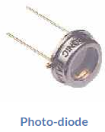
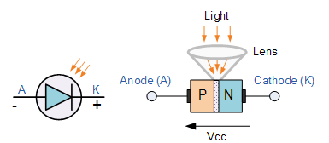
a) The Photodiode.
The construction of the Photodiode light sensor is similar to that of a conventional PN-junction diode except that the diodes outer casing is either transparent or has a clear lens to focus the light onto the PN junction for increased sensitivity.

Slide 55
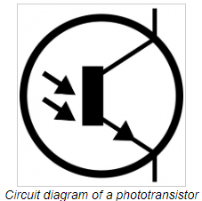
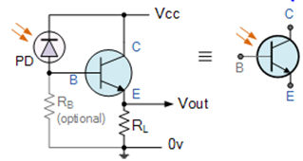
b) Phototransistor:
A phototransistor, on the other hand, uses the level of light it detects to determine how much current can pass through the circuit.
So, if the sensor is in a dark room, it only lets a small amount of current through.
If it detects a bright light, it lets a larger amount of current through.

Slide 56
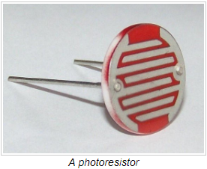
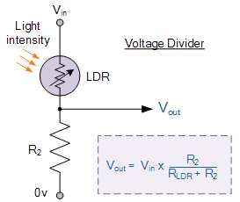
c)Photoresistor:
A photoresistor operates similarly to a phototransistor however it changes its resistance based on the amount of light that falls upon it.
Photoresistors tend to be less sensitive,

Slide 57
8) Position and Motion Sensors
They are able to perform precise motion control, encoding and counting functions by determining the presence or absence of a target or by detecting its motion, speed, direction or distance.
Position sensors detect a target object, a person, a substance or the disturbance of a magnetic or an electrical field and convert that physical parameter to an electrical output to indicate the target’s position.

Slide 58
Types of Position Sensors
a) Contact devices:
Limit switches
Resistive position transducers
B) Non-contact devices
Ultrasonic sensors
Proximity sensors
Photoelectric sensors

Slide 59
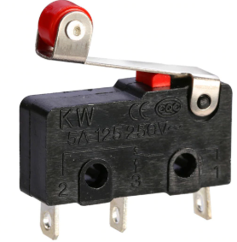
a)Limit Switches
Limit switches are electromechanical contact devices. These are small electrical switches which require physical contact and a small operating force to close the contacts.

Slide 60
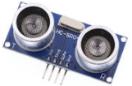
b) Ultrasonic position sensors
Ultrasonic sensors work by exciting an acoustic transducer with voltage pulses,
These oscillations are directed at a target and, by measuring the time for the echo to return to the transducer.
Ultrasonic sensors provide precise no-touch presence/absence sensing and distance sensing or tracking.

Slide 61
c) Photoelectric sensors
Photoelectric sensors use an emitter unit to produce a beam of light that is detected by a receiver.
When a beam is broken indicates a “presence is detected”.

Slide 62
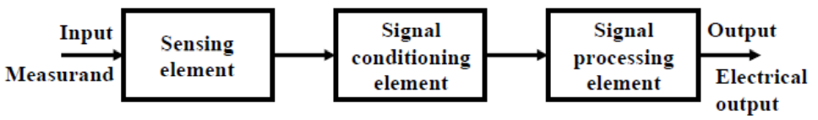
SIGNAL CONDITIONING CIRCUITS
Measurement system consists mainly of the three blocks: sensing element, signal conditioning element and signal processing element.
The sensing element converts the non-electrical signal (e.g. temperature) into electrical signals (e.g. voltage, current, resistance, capacitance etc.).
The job of the signal conditioning element is to convert the variation of electrical signal into a voltage level suitable for further processing.
The next stage takes the output of the signal conditioning element and converts into a form more suitable for presentation and other uses (display, recording, feedback control etc.)
Most signal conditioning circuits use standard blocks like bridges (A.C. and D.C.), amplifiers and filters.

Slide 63

Questions and Discussions
Thank you

Slide 64
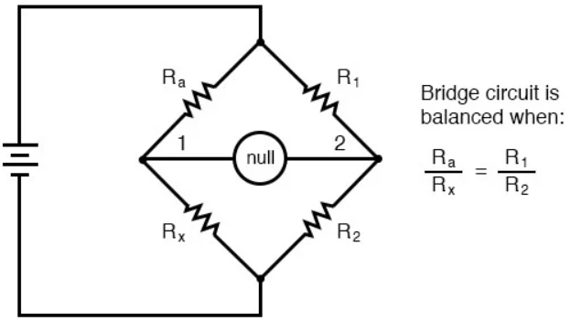
Wheatstone Bridge
These ingenious circuits make use of a null-balance meter to compare two voltages.
Bridge can be useful way to measure unknown values of resistance.
To measure resistance with a Wheatstone bridge, Any one of the four resistors in the above bridge can be the resistor of unknown value,, while the other three resistors are precision devices of known value.

Slide 65
Operational amplifier
An op-amp is considered as a circuit element (integrated circuit) built without the necessity of knowing about its complex internal circuit configuration.
The first operational amplifier was used in the analog computers to perform a variety of mathematical operations such as addition, subtraction, multiplication , integration etc.
Due to its use in performing mathematical operations it has been given a name operational amplifier.

Slide 66
Op amp Symbol and Terminals
All op-amps have at least five terminals: 1. Inverting input terminal, 2. Non-inverting input terminal, 3. Output terminal, 4. Positive power supply terminal Vcc 5. Negative power supply terminal V_{EE}.

Slide 67
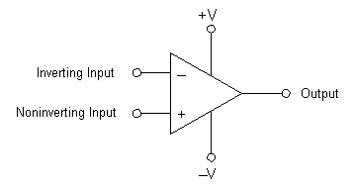
Cont’d
The operational amplifier has two inputs:
Inverting input: is marked with a "-" sign on circuit schematic diagrams.
Non-inverting input: is marked with a "+" sign.
The op-amp symbol is a triangle that points in the direction of signal flow.

Slide 68
Cont’d
Inverting Input, marked with a negative or "minus" sign, ( - ). When a signal is applied at the inverting input, a corresponding and opposite phase is produced at the output.
Non-inverting Input, marked with a positive or "plus" sign ( + ). Applying a signal to the non-inverting input of the circuit results in an identical phase produced at the output.

Slide 69
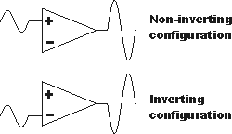
Cont’d

Slide 70
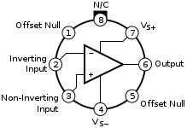
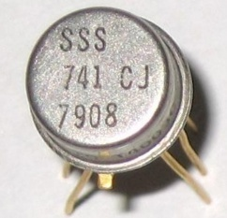
Op Amp Packages
The op-amp ICs are available in various packages.
The metal can package

Slide 71
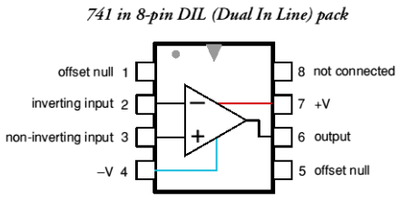
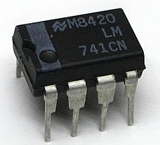
b)The dual in line package:
For Dual In Line-package), is an electronic device package with a rectangular housing and two parallel rows of electrical connecting pins. The pins are all parallel and point downward.

Slide 72
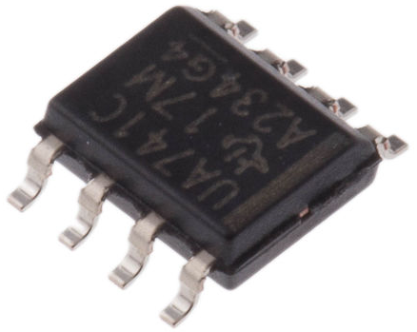
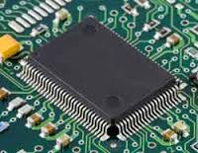
c) The flat package or flat pack:
A Flat Pack IC is a surface mount component that contains pins, on each side of the body. Note how the leads are formed

Slide 73
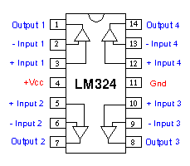
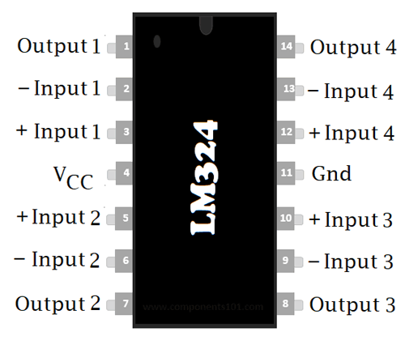
A single package will often contain several op-amps

Slide 74
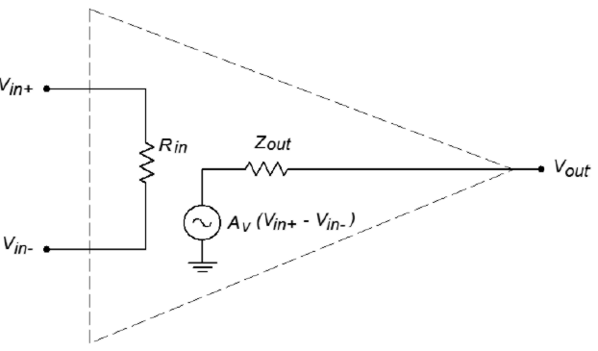
THE IDEAL OP-AMP
Ideal Op-Amp is an op-amp without fault. It can be defined as the best possible op-amp. It is perfect, the best possible or the right type of op-amp.

Slide 75
An ideal op amp characteristics:
The output of the ideal differential input amplifier depends only on the difference between the voltages applied to the two input terminals.
No current flows into the amplifier input terminals.
When the input signal voltage is zero, the output signal will also be zero regardless of the input source resistance.
Input impedance of an amplifier is infinite
Output voltage is zero when inverting and non-inverting voltages are equal.

Slide 76
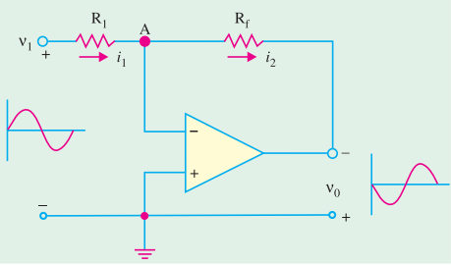
1. Inverting amplifier
Non-inverting terminal has been grounded, whereas R₁connects the input signal ν₁ to the inverting input. A feed-back resistor R_{f} has been connected from the output to the inverting input.

Slide 77
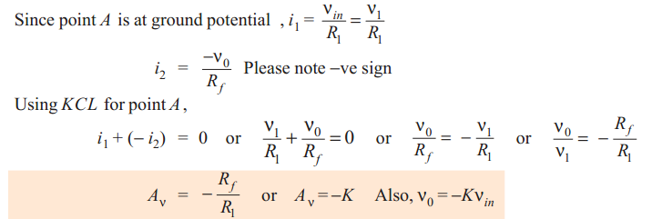
Gain of inverting amplifier

Slide 78
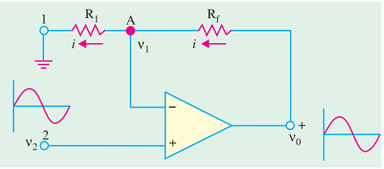
2. Non-inverting Amplifier
Such a circuit uses negative feedback but provides an output that equals the input multiplied by a positive constant is shown in Figure below.

Slide 79
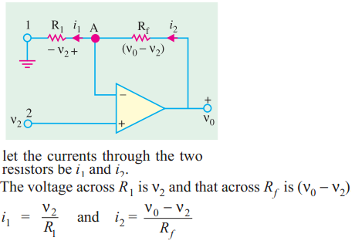
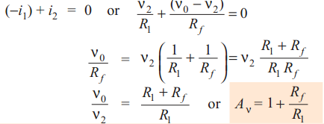
Cont’

Slide 80
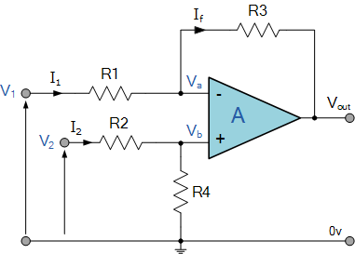

6. The Differential Amplifier/ Subtractor
The differential amplifier configuration is a combination of the inverting and non-inverting voltage amplifiers.
Remember, for the inverting input the gain magnitude is R_{f}/R_{i}, whereas the non-inverting input sees R_{f}/R_{i} + 1.

Slide 81
Questions and Discussions
Thank you

